Slide 1
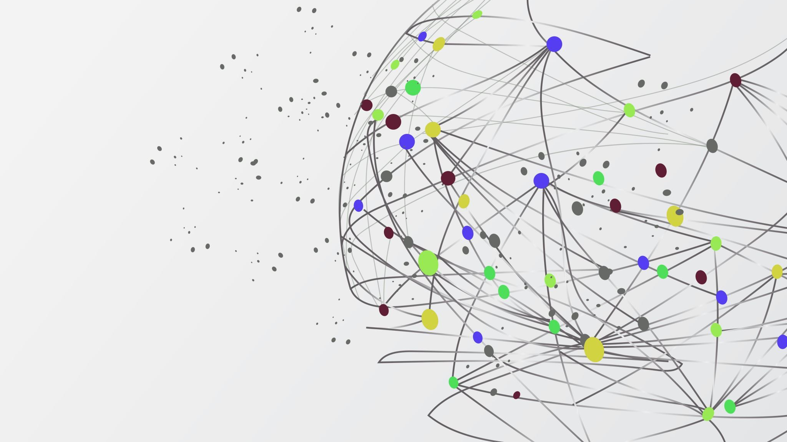
Breast Cancer Detection using ML
A Machine Learning Approach to Diagnose Tumors

Slide 2
Introduction
Problem Statement:
Breast cancer is a major health issue globally.
Early detection improves treatment outcomes.
Goal: To use ML models to classify tumors as Benign (B) or Malignant (M).

Slide 3
Dataset Overview
Property | Value
Records (Patients) | 569
Features (Columns) | 30 numerical features
Target Variable | Diagnosis
Classes | B (Benign) - 357M (Malignant) - 212
Missing Values | 0

Slide 4
Libraries Used
Library | Purpose
numpy | Numerical computations, matrix operations
pandas | DataFrame operations for loading, inspecting, and manipulating data
matplotlib.pyplot | Basic visualizations (bar chart, line plots)
seaborn | Enhanced statistical plots (heatmap, countplot)
ucimlrepo | One-line access to UCI ML datasets
sklearn.model_selection | Splitting dataset, cross-validation
sklearn.preprocessing | Scaling features using StandardScaler
sklearn.ensemble | Random Forest Classifier (ensemble learning)
sklearn.naive_bayes | Gaussian Naive Bayes model
sklearn.linear_model | Logistic Regression
sklearn.svm | Support Vector Classifier
sklearn.metrics | Accuracy, classification report, confusion matrix

Slide 5
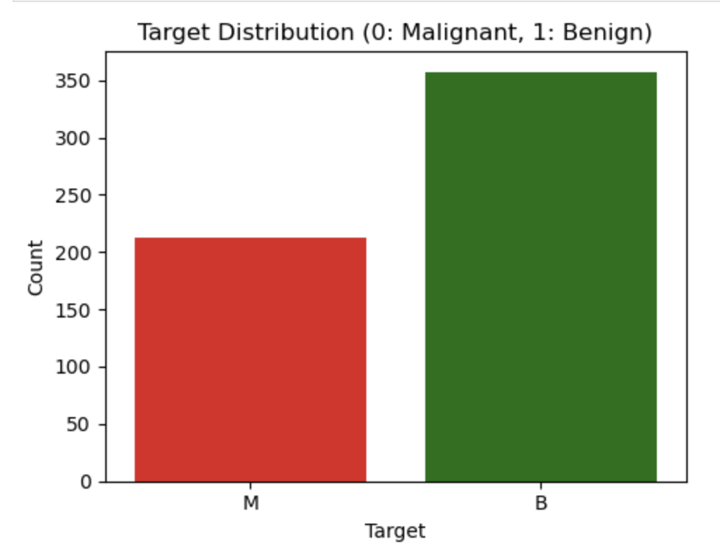
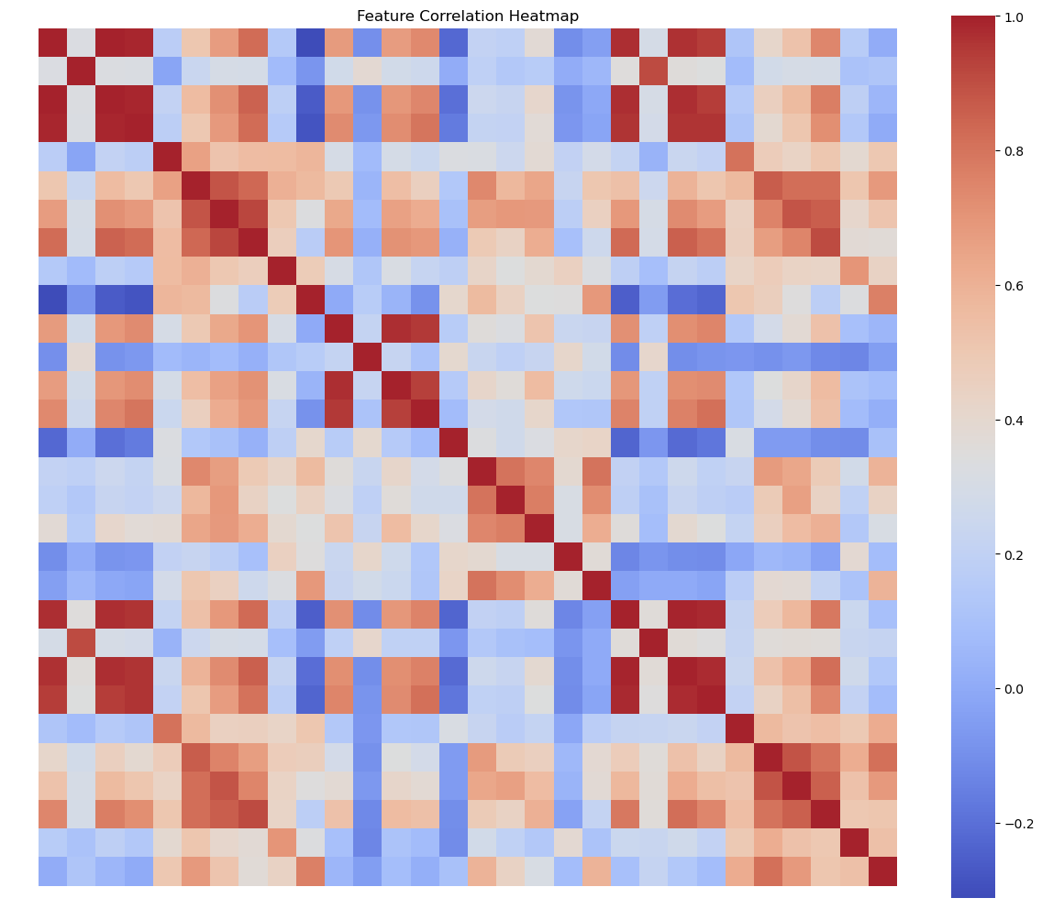
Exploratory Data Analysis

Slide 6
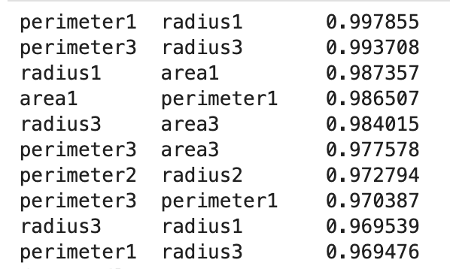

Slide 7
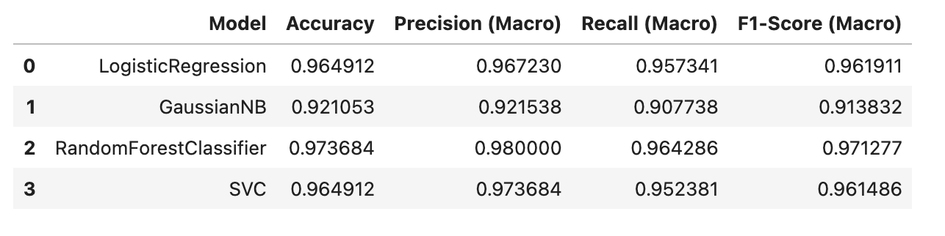
Machine Learning Models- Summary

Slide 8
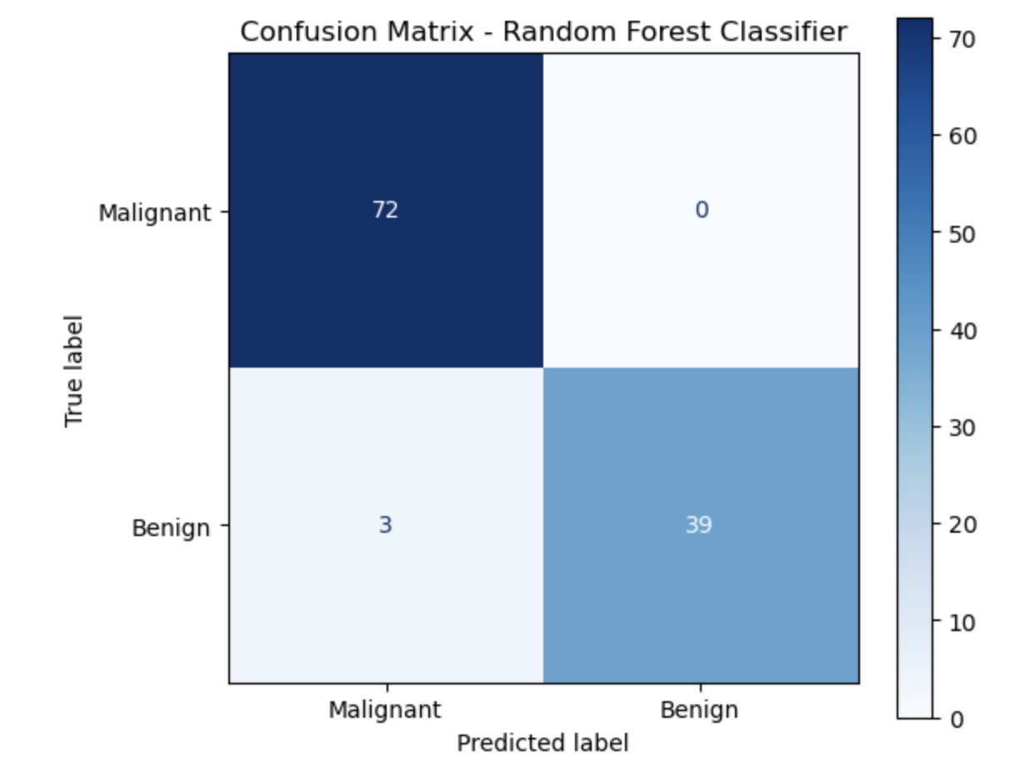
Confusion Matrix – Best Model

Slide 9
Interpretation
True Negatives (72)
The model correctly identified 72 malignant tumors, meaning it successfully caught those that required urgent attention.
True Positives (39)
It also correctly predicted 39 benign tumors, avoiding unnecessary alarm or treatment.
False Negatives (3)
The model misclassified 3 benign tumors as malignant, which could cause unnecessary anxiety or treatment — but this is less dangerous than missing an actual cancer.
False Positives (0)
Most critically, the model did not misclassify any malignant tumors as benign, which is essential in cancer detection — we don't want to miss a real case.

Slide 10
Key Takeaways
High Sensitivity: The model is excellent at detecting malignant cases (no false positives).
Low Error Rate: Only 3 benign tumors were misclassified — a tolerable error in this domain.
Overall: The Random Forest model is reliable and safe for this classification task, prioritizing patient safety.

Slide 11

Thank You

